Slide 1

Object Oriented Analysis and Design
By
R.Vignesh,M.E(Ph.D)
Assistant Professor

Slide 2
UNIT 1
AN OVERVIEW OF OBJECT ORIENTED SYSTEM DEVELOPMENT
Introduction - Object Oriented System Development Methodology - Why Object Orientation - Overview of Unified Approach - Object Basics: Object Oriented Philosophy - Objects - Classes - Attributes - Object Behavior and Methods, Encapsulation and Information Hiding - Class Hierarchy - Polymorphism - Object Relationships and Associations - Aggregations and Object Containment - Object Identity - Static and Dynamic Binding - Persistence. Object Oriented Systems Development Life Cycle: Software Development Process - Building High Quality Software - Usecase Driven Approach - Reusability.

Slide 3
Introduction
Object-Oriented Development uses "objects" to model real world objects.
Eg: A car or a laptop can be considered as object. While traditional programming views software as a collection of functions, an object oriented system concentrates on the objects that combines data and functionality together.
The traditional approach mostly focused on structured system development and the technique used was usually referred to as the Structured Analysis and Design Technique (SADT).

Slide 4
Object
An object is something which has its own identity and can be easily compared to a real world object like a car or a laptop.
An object contains a state and some behavior.
The state of an object is the properties of the object at a particular time, and behavior is the functions it will perform.
The behavior of an object is usually described using methods, and these methods will be part of the object itself
So you don't have to refer anywhere else for object's functionality, whereas in function based traditional approach you need to remember all the methods and their location
For instance, in java, the state of an object is the set of values of an object's variables at any particular time and the behavior is implemented as methods.

Slide 5
Class
Objects are grouped into a class. A class can be defined as a group of objects with the same structure and behaviour.
Class can be considered as the blueprint or definition or a template for an object and describes the properties and behavior of that object, but without any actual existence.
An object is a particular instance of a class which has actual existence and there can be many objects (or instances) for a class.
In the case of a car or laptop, there will be a blueprint or design created first and then the actual car or laptop will be built based on that.
We do not actually buy these blueprints but the actual objects.

Slide 6
Object oriented development
In Object-Oriented Development, we apply object orientation across every system development activity such as requirement analysis, design, programming, testing, and maintenance.
For instance, an object oriented analysis (OOA) will usually have the following steps:
Identifying the system functionality
Identifying the involved objects
Recognizing the object classes
Analyzing the objects to fulfill the system functionality
Object-Oriented Programming (OOP) is based on object oriented features like Encapsulation, Polymorphism, Inheritance and Abstraction. These features are usually referred to as the OOPs concepts.

Slide 7
Encapsulation
Encapsulation is the process of wrapping up of data ( as properties) and behavior (as methods) of an object into a single unit (a class).
Encapsulation enables data hiding, hiding irrelevant information from the users of a class and exposing only the relevant details required by the user. We can expose our operations to the outside world and hide the details of what is needed to perform that operation.
Example from real world: Consider the smart phone you are using now. You are not worried about the internal operations of the smart phone. You only know and care about the operations or functions it exposes to you such as making call, sending SMS or using your apps.

Slide 8
Inheritance
Inheritance describes the relationship between two classes.
A class can get some of its characteristics from a parent class and then add unique features of its own.
For example consider a Vehicle parent class and its child class Car.
Vehicle class will have all common properties and functionalities for all vehicles in common and Car will inherit those common properties from the Vehicle class and then add those properties which are specific to a car. \
Here, Vehicle is known as base class, parent class, or superclass. Car is known as derived class, Child class or subclass.
In multiple inheritance a class can inherit from more than one parent, but due to its complexity some languages like Java doesn't fully support it. In multi-level inheritance there will be many levels of inheritence like A inheriting from B and B inheriting from C and so on.

Slide 9
Polymorphism
Polymorphism means that one operation can be used for different purposes.
Poly means many and morph means form.
For instance, Java supports different kinds of polymorphism like oveloading, overriding, parametric etc.
In overloading, the multiple methods having same name can appear in a class, but with different signature.
Overriding is defining a method in a subclass with the same name and type signature as a method in its superclass and the overriden method is called at runtime based on the object at runtime.

Slide 10
Abstraction
Abstraction in OOP emphasizes what is important and what is not important at a particular level of detail.
Abstraction refers to the ability to make a class abstract at a level and define some of the behaviour at each level, relevant to the current perspective.
Abstraction allows the programmer to focus on few concepts at a time.
Java provides interfaces and abstract classes for describing abstract types.

Slide 11
Coupling and cohesion
Coupling and cohesion are two important concepts in the Object Oriented design and hence we will briefly discuss it here.
Coupling is the degree to which one class knows about another class.
If the knowledge is only through exposed interfaces (data hiding), it is called loosely coupled.
If the knowledge is more like accessing data members directly, it is called tightly coupled.
We should try to make our code as loosely coupled as possible.

Slide 12
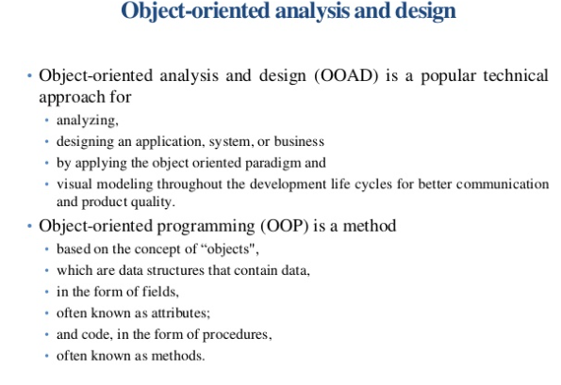

Slide 13
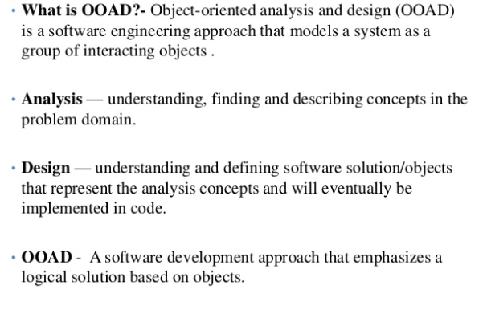

Slide 14
The term cohesion is used to indicate the degree to which a class has a single, well-focused purpose.
The more focused a class is, the higher its cohesiveness, which is a good thing.
The key benefit of high cohesion is that such classes are typically much easier to maintain than classes with low cohesion.
Another benefit of high cohesion is that classes with a well-focused purpose tend to be more reusable than other classes.
In summary, loose coupling and high cohesion are desirable, whereas tight coupling and less cohesion can lead you to problems in the long run.

Slide 15
Advantages of object oriented software development
Some of the advantages of object oriented software development are:
Less maintenance cost mostly because it is modular.
Better code reusability due to features such as inheritance and hence faster development.
Improved code reliability and flexibility
Easy to understand due to realworld modelling.
Better abstraction at object level.
Reduced complexity during the transitions from one development phase to another.

Slide 16
Object Oriented System Development Methodology:
Object Oriented Methodology (OOM) is a system development approach encouraging and facilitating re-use of software components.
With this methodology, a computer system can be developed on a component basis which enables the effective re-use of existing components and facilitates the sharing of its components by other systems.
Object oriented systems development methodology develops software by building objects that can be easily replaced , modified and reused.
It is a system of cooperative and collaborating objects.
Each objects has attributes (data) and methods (functions).

Slide 17
Why an object orientation?
Object oriented systems are
• Easier to adapt to changes
• More robust
• Easier to maintain
• Promote greater design and code reuse
• Creates modules of functionality

Slide 18
Reasons for working of object oriented systems:
Higher level of abstraction
Seamless transition among different phases of software development
Encouragement of good programming techniques
Promotion of reusability
Higher level of abstraction

Slide 19
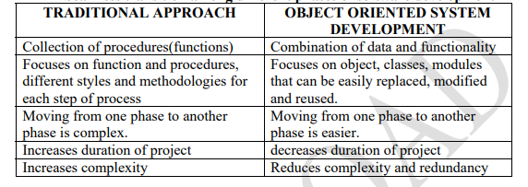

Slide 20
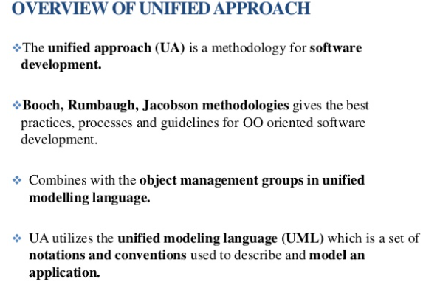

Slide 21
The UML (Unified Modeling Language) is a set of notations and conventions used to describe and model an application.
The Unified Approach (UA) specifies the tasks or steps to develop an application

Slide 22
The use case represents a typical interaction between a user and a computer system to capture the users’ goals and needs.
In its simplest usage, you capture a use case by talking to typical users and discussing the various ways they might want to use the system.
The use cases are entered into all other activities of the UA.
The UA establishes a unifying and unitary framework around their works by utilizing the UML to describe the model and document the software development process.
The idea behind the UA is not to introduce yet another methodology.
The main motivation here is to combine the best practices, processes, methodologies, and guidelines along with UML notations and diagrams for better understanding of object-oriented concepts and system development.

Slide 23
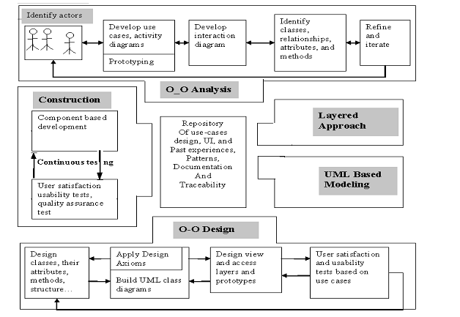
The processes and components of the unified approach

Slide 24
The unified approach to software development revolves around (but is not limited to) to the following processes and concepts. The processes are:
1. Use-case driven development
2. Object-oriented analysis
3. Object-oriented design
4. Incremental development and prototyping
5. Continuous testing

Slide 25
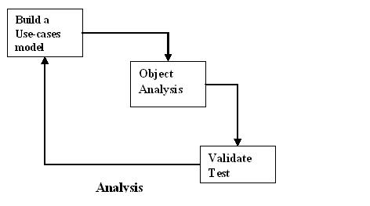
Object-Oriented Analysis
Analysis is the process of extracting the needs of a system and what the system must do to satisfy the users’ requirements.
The goal of object-oriented analysis is to first understand the domain of the problem and the system’s responsibilities by understanding how the users use or will use the system.
It concentrates on describing what the system does rather than how it does it.

Slide 26
Separating the behavior of a system from the way it is implemented require viewing the system from the user’s perspective rather than that of the machine.
OOA process consists of the following steps:
1. Identify the Actors.
2. Develop a simple business process model using UML Activity diagram.
3. Develop the Use Case.
4. Develop interaction diagrams.
5. Identify classes.

Slide 27
Object-Oriented Design
Object – oriented design plays a major role in the performance process.
While there are many factors that contribute to a good design, and all of them are important, there is one concept that is especially critical to creating high-performance systems.
This concept is called encapsulation.
Making encapsulation part of your design from the start enables you to:

Slide 28
OOD process consist of,
Designing classes, their attributes, methods, associations, structures and protocols, apply design axioms
Design the Access Layer
Design the prototype user interface
User satisfaction and usability tests based on the usage/use cases
Iterate and refine the design

Slide 29
Iterative development and continuous testing:
Iterate and Reiterate until you are satisfied with the system.
Testing uncovers the design weaknesses or provides additional information.
Repeat the entire process, taking what you have learned and reworking you design more onto re-prototyping and retesting.
Unified Approach encourages integration testing from the day 1 of the project usage scenarios can become test scenarios.
There four use cases will drive usability testing

Slide 30
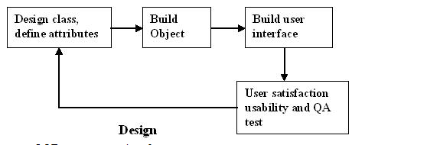
Quickly evaluate different algorithms and data structures to see which is most efficient.
Easily evolve your design to accommodate new or changed requirements.

Slide 31
1. Designing classes, their attributes, methods, associations, structures and protocols, apply design axioms.
2. Design the Access Layer
3. Design and prototype User interface
4. User Satisfaction and Usability Tests based on the Usage/Use Cases
5. Iterated and refine the design

Slide 32
Modeling based on the Unified Modeling Language:
UML is becoming the universal language for modeling systems; it is intended to be used to express models of many different kinds and purposes.
UML has become the standard notation for object oriented modeling systems.
The Unified Approach uses the UML to describe and model the analysis and design phases of system development.

Slide 33
Unified Approach Proposed Repository:
Best practice sharing eliminates duplication of problem solving. It must be applied to application development, if quality and productivity are to be added.
The idea promoted here is to create a repository that allows the maximum reuse of previous experience and previously defined objects, patterns, frameworks etc in an easily accessible manner.
It should be accessible to many people.

Slide 34
Advantages:
If your organization has done projects in the past, objects in the repositories from those projects might be useful.
Creating additional applications will require no more than assembling components from the library.
Applying lessons learned from the part will increase the quality of the product and reduce the cost and development time.

Slide 35
Layered Approach to Software Development: Three layered approaches,
Business Layer:
The business layer contains all the objects that represent the business.
The responsibilities of business layer are very straightforward.
“Model the objects of the business and how they interact to accomplish the business processes.”
A business model captures the static and dynamic relationships among a collection of business objects.
These objects should not be responsible for Displaying details and Data Access details.

Slide 36
View Layer / User Interface Layer:
It consists of objects with which the user interacts as well as the objects needed to manage or control the interface.
There objects are identified during the object oriented design phase.
This layer is responsible for 2 major aspects.
Responding to user interaction and displaying business
Access Layer:
It contains objects that know how to communicate with the place where the data actually reside, whether it be a relational database, mainframe, Internet or file.It has two major responsibilities, Translate request and Translate result.

Slide 37

OBJECT BASICS
INTRODUCTION TO THE OO APPROACH
Object-oriented approaches attempt to build models that mimic the “real world”
Many systems we want to build involve things that exhibit behavior as well as having structure, and also may exhibit time-dependent aspects
OO approaches attempt to consistently capture all these aspects

Slide 38
OBJECT ORIENTED PHILOSOPHY
The programming languages provide the programmers the way of
describing the process.
The ease of description, reusability, extensibility, readability, computational efficiency, and ability to maintain depends on languages used.
System Software – Machine Understandable language (Integers, floating point numbers, chars, Addressing Modes,….)
Eg., Financial Investment →Development of Financial Investment Machine directly would reduce translation

Slide 39
Object-Oriented Programming Concepts allows closer ideas and terms for the development of certain applications.
Financial Investment :
Bond (data type) → character
Buy operation on a bond (+) →operation on a number

Slide 40
OBJECT’S ATTRIBUTES
Attributes represented by data type.
They describe objects states.
In the Car example the car’s attributes are:
color, manufacturer, cost, owner, model, etc.

Slide 41
Object Method
Methods define objects behavior and specify the way in which an Object’s data are manipulated.
In the Car example the car’s methods are:
drive it, lock it, tow it, carry passenger in it.

Slide 42
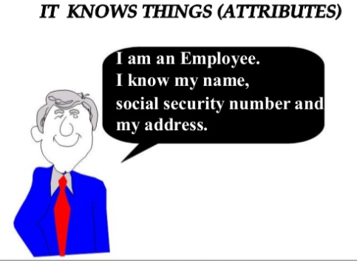

Slide 43
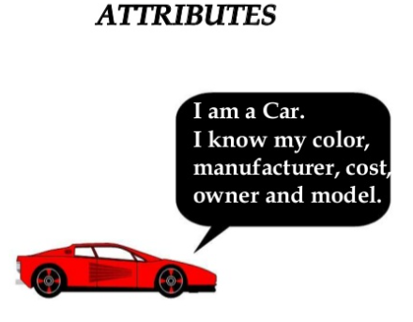

Slide 44
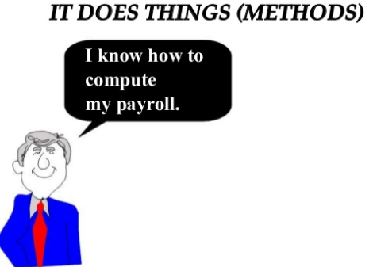

Slide 45
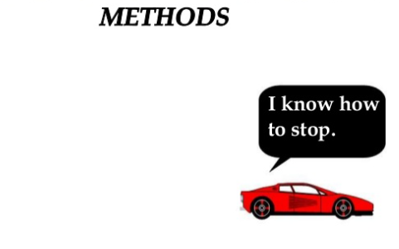

Slide 46
Object is whatever an application wants to talk about
For example, Parts and assemblies might be objects of bill of material application.
Stocks and bonds might be objects of financial investment applications.

Slide 47
The role of a class is to define the attributes and methods(the state and behaviour) of its instances.
Used to distinguish one type of object from the other.
Set of objects, that share common methods, structure, behaviour.
Single object is simply an instance of class.
The class car, for example, defines the property color. Each individual car (object) will have a value for this property, such as "maroon," "yellow" or "white."

Slide 48
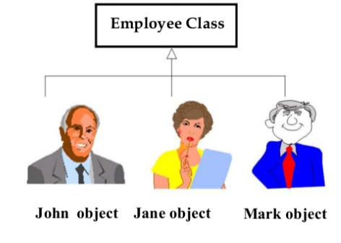

Slide 49
CLASS
A class represents a collection of objects having same characteristic properties that exhibit common behavior.
Creation of an object as a member of a class is called instantiation.
Thus, object is an instance of a class.
Example: Circle – a class
x, to the center
a, to denote the radius of the circle
Some of its operations can be defined as follows: findArea(), method to calculate area
findCircumference(), method to calculate circumference

Slide 50
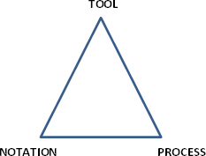
Object oriented Methodologies
Many methodologies have been developed for object
oriented development.
A methodology usually includes
Notation : Graphical representation of classes and their
relationships with interactions.
• Process : Suggested set of steps to carry out for transforming requirements into a working system.
• Tool : Software for drawings and documentation

Slide 51
UML – Unified modeling language
UML focuses on standard modeling language and not a
standard process.
UML focuses the concept of Booch,
Rambaugh and Jacobson.
• The UML is a standard graphical design for object- oriented graphical design and a medium for presenting important analysis and design concepts.

Slide 52
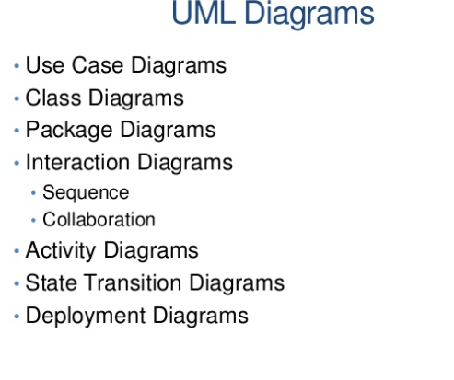

Slide 53
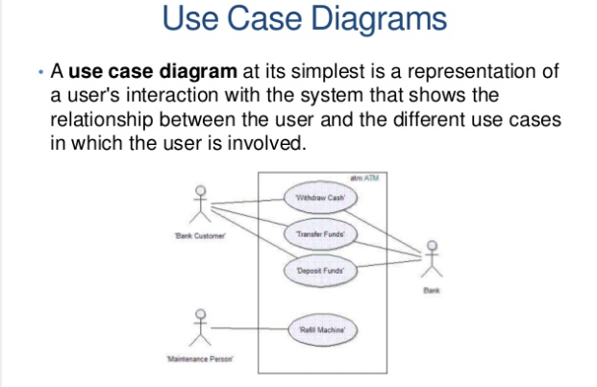

Slide 54
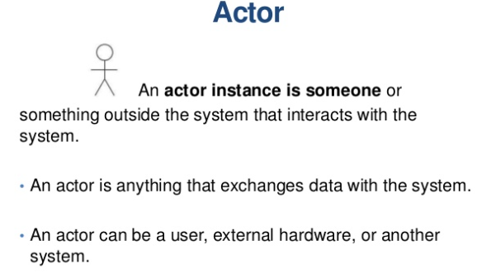

Slide 55
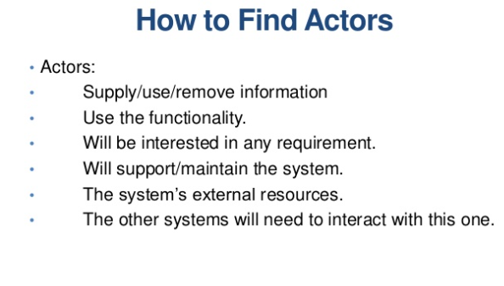

Slide 56
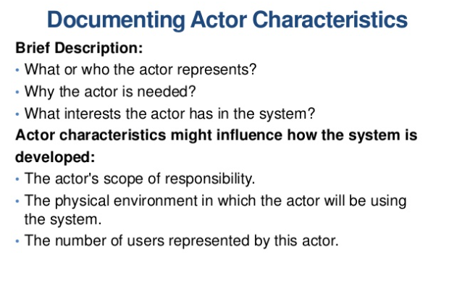

Slide 57
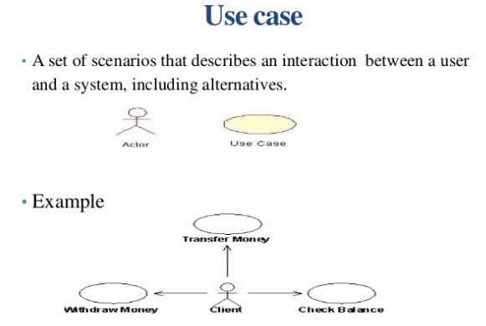

Slide 58
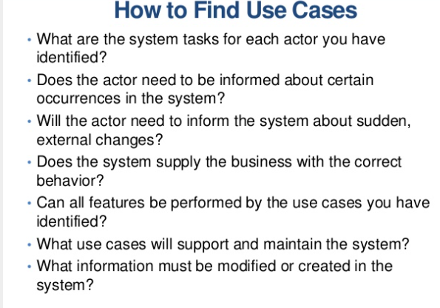

Slide 59
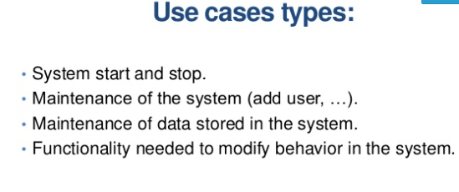

Slide 60
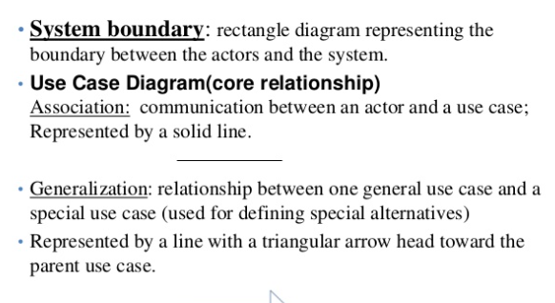

Slide 61
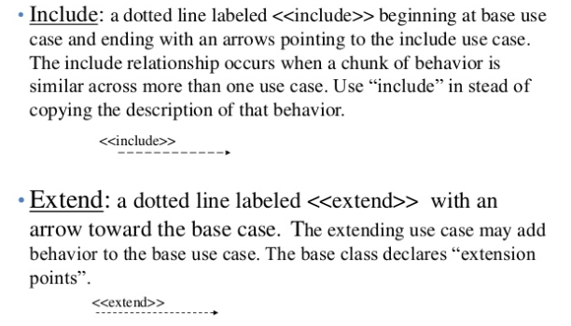

Slide 62
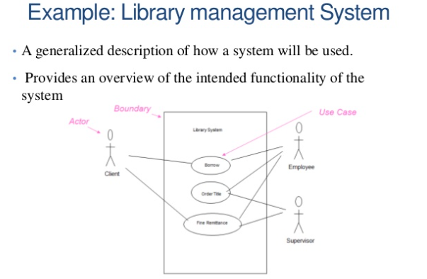

Slide 63
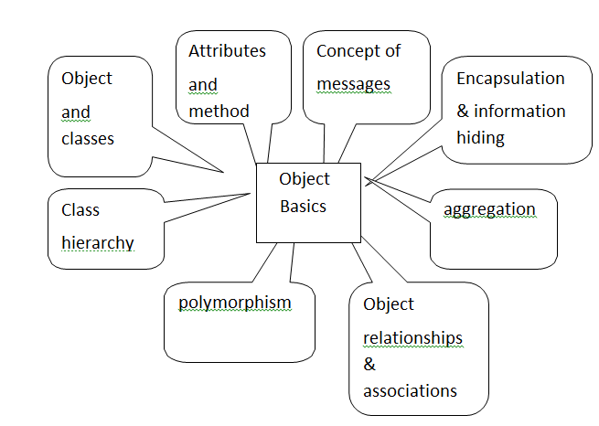
OO CONCEPTS

Slide 64
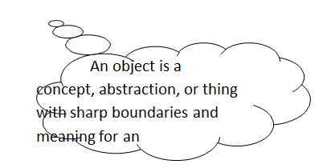
OBJECT AND CLASSES
informally , an object represents an entity, either physical, conceptual, or software
physical entity
conceptual entity
software entity
In an OO system, everything is an object
Classes are used to distinguish one type of object from another
A Class = a set of objects that share a common structure and a common behaviour

Slide 65
A single object is simply an instance of a class
A class is a specification of structure (instance variables), behavior(methods), and inheritance for objects
Classes are an important mechanism for classifying objects
Main role of a class is to define the properties and procedures (the state & behavior) and applicability of its instances.

Slide 66
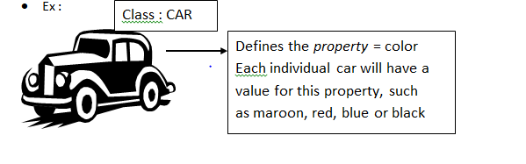
In an OO system, a method or behavior of an object is defined by its class
Each object is an instance of a class

Slide 67
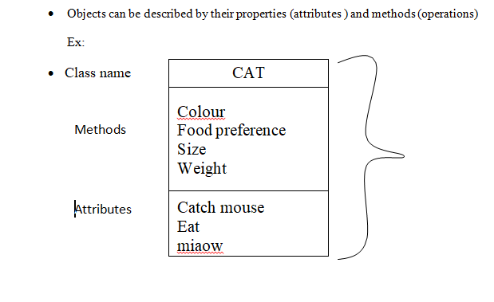
Attributes And Methods

Slide 68
object behavior is described in methods or procedures
a method = a function or procedure that is defined for a class and typically can access the internal state of an object of that class to perform some operation
operations are things an object does or can have done to it
in an object model, all data is stored as attributes of some object
the attributes of an object are manipulated by the operations

Slide 69
Concept of Messages
Objects interact with each other by sending and receiving messages
Messages are similar ro procedure calls in traditional programming languages
Objects perform operations in response to messages
Ex : when you press on the brake pedal of a car, you send a STOP message to the car object. The car object knows how to respond to the STOP message

Slide 70
Encapsulation & Information Hiding
Information hiding is the principle of concealing the internal data and procedures of an object and providing an interface to each object in such a way as to reveal as little as possible about its inner workings
An object is said to encapsulate the data and a program.
Encapsualtion or information hiding is a design goal of an OO system
In object-oriented system, everything is an object and each object is responsible for itself.

Slide 71
For example:
Windows applications needs windows object that can open themselves on screen and either display something or accept input.
Windows object is responsible for things like opening, sizing, and closing itself.
When a windows display something, that something is an object. (ex)chart.
Chart object is responsible for maintaining its data and labels and even for drawing itself.

Slide 72
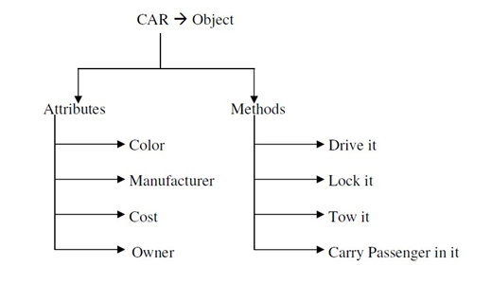
Review of objects:
The object-oriented system development makes software development easier and more natural by raising the level of abstraction to the point where applications can be implemented.
The name object was chosen because “everyone knows what is an object is ”. The real question is “what do objects have to do with system development” rather that “what is an object?”
A car is an object a real-world entity, identifiably separate from its surroundings. A car has a well-defined set of attributes in relation to other object.

Slide 73
Attributes:
Data of an object.
Properties of an object.
Methods:
Procedures of an object.or
Behaviour of an object.
The term object was for formal utilized in the similar language. The term object means a combination or data and logic that represent some real-world entity.
When developing an object oriented applications, two basic questions arise
What objects does the application need?
What functionality should those objects have?
Programming in an object-oriented system consists of adding new kind of objects to the system and defining how they behave. The new object classes can be built from the objects supplied by the object-oriented system.

Slide 74
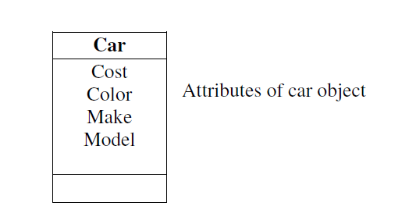
Object state and properties (Attributes):
Properties represent the state of an object. In an object oriented methods we want to refer to the description of these properties rather than how they are represented in a particular programming language.

Slide 75
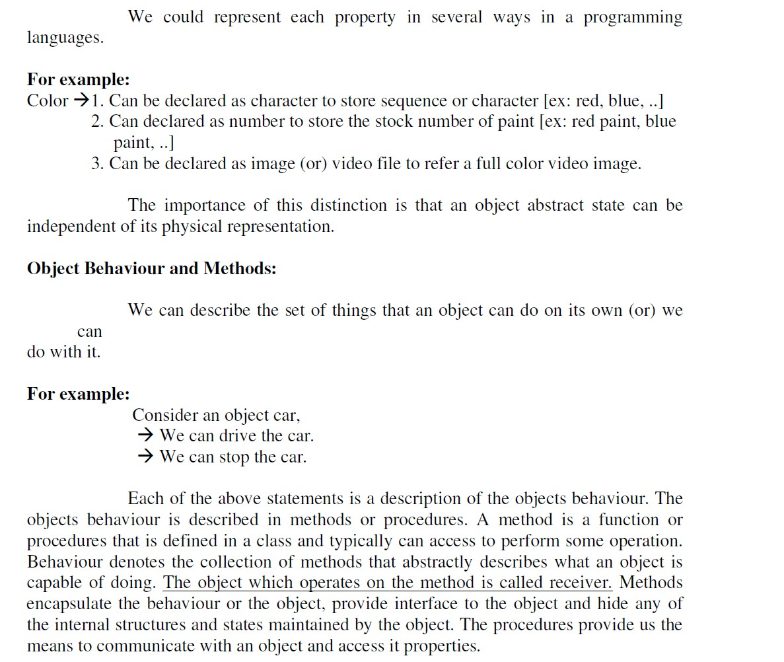

Slide 76
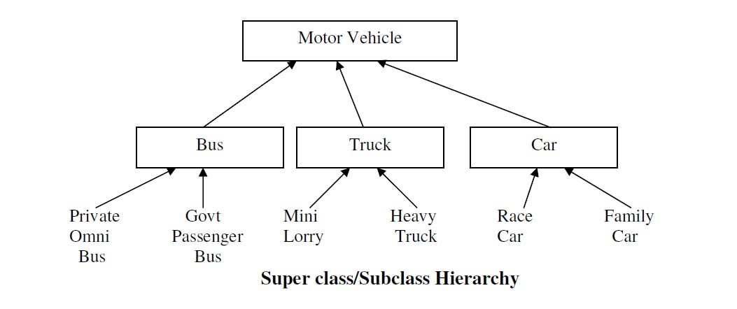
Class Hierarchy
An object-oriented system organizes classes into a subclass super class hierarchy.
The properties and behaviors are used as the basis for making distinctions between classes are at the top and more specific are at the bottom of the class hierarchy.
The family car is the subclass of car. A subclass inherits all the properties and methods defined in its super class.

Slide 77
Inheritance:
It is the property of object-oriented systems that allow objects to be built from other objects.
Inheritance allows explicitly taking advantage of the commonality of objects when constructing new classes.
Inheritance is a relationship between classes where one class is the parent class of another (derived) class.
The derived class holds the properties and behaviour of base class in addition to the properties and behaviour of derived class.

Slide 78
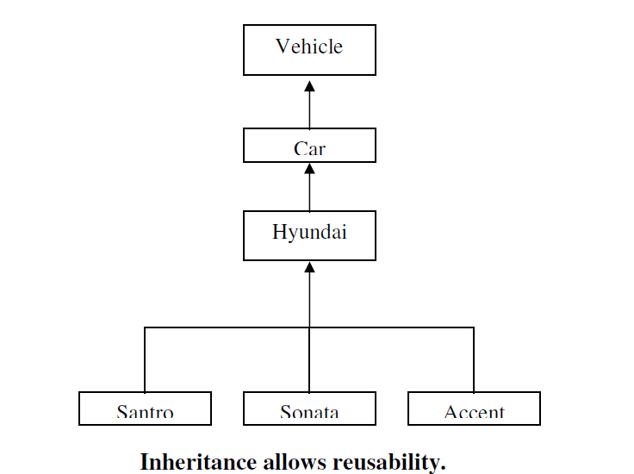

Slide 79
Dynamic Inheritance:
Dynamic inheritance allows objects to change and evolve over time. Since base classes provide properties and attributes for objects, hanging base classes changes the properties and attributes of a class.
Example:
A window objects change to icon and basic again. When we double click the folder the contents will be displayed in a window and when close it, changes back to icon. It involves changing a base class between a windows class and icon class.
Multiple Inheritances:
Some object-oriented systems permit a class to inherit its state (attributes) and behaviour from more than one super class. This kind or inheritance is referred to as multiple inheritances.

Slide 80
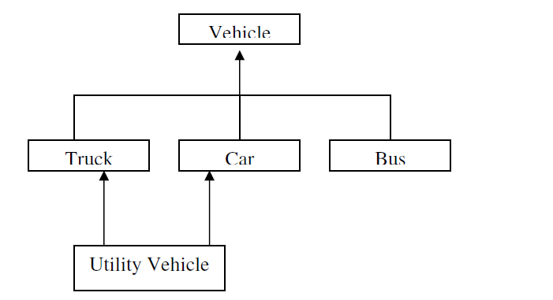
For example:
Utility vehicle inherits the attributes from the Car and Truck classes.

Slide 81
Encapsulation and Information Hiding:
Information hiding is the principle of concealing the internal data and procedures of an object. In C++ , encapsulation protection mechanism with private, public and protected members.
In per-class protection:
Class methods can access any objects of that class and not just the receiver.
In per-object protection:
Methods can access only the receiver. An important factor in achieving encapsulation is the design at different classes of objects that operate using a common protocol.
This means that many objects will respond to the message using operations tailored to its class.
A car engine is an example of ncapsulation. Although engines may differ in implementation, the interface between the driver and car is through a common protocol.

Slide 82
Polymorphism:
Poly _ ”many” Morph _ “form”
It means objects that can take on or assume many different forms.Polymorphism means that the same operations may behave differently on different classes.
Booch defines polymorphism as the relationship of objects many different classes by some common super class.
Polymorphism allows us to write generic, reusable code more easily, because we can specify general instructions and delegate the implementation detail to the objects involved.

Slide 83
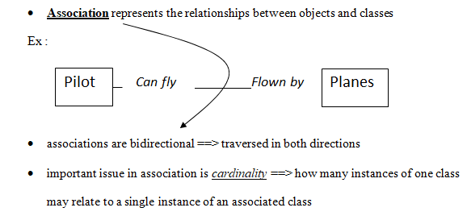
Object Relationships & Associations

Slide 84
Aggregations:
All objects except the most basic ones, are composed of and may contain other objects.
Ex : a spreadsheet is an object composed of cells, and cells are objects that may contain text, mathematical formulas, etc:
Breaking down objects into the objects from which they are composed is decomposition
Aggregation ----->where an attribute can be an object itself

Slide 85
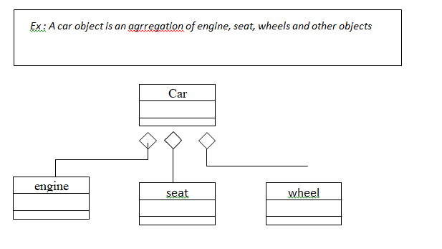

Slide 86
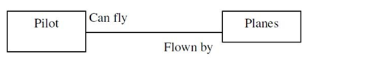
Object Relationship and associations:
Association represents the relationships between objects and classes. Associations are bidirectional. The directions implied by the name are the forward direction and the opposite is the inverse direction.
A pilot “can fly” planes. The inverse of can fly is “is flown by “. Plane “is flown by” pilot

Slide 87
Cardinality:
It specifies how many instances of one class may relate to a single instance of an associated class. Cardinality constrains the number of related objects and often is described as being “one” or “many”.
Consumer-producer association:
A special form or association is a consumer-producer relationship, also known as a client-server association (or) a use relationship.
It can be viewed as one-way interaction.
One object requests the service or another object.
The object that makes the request is the consumer or client and the object that receives the request and provides the service is the producer (or) server

Slide 88
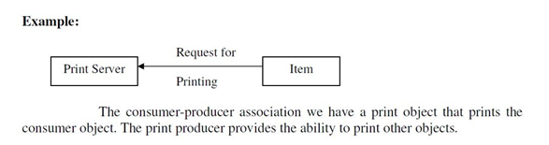

Slide 89
Aggregations:
All objects, except the most basic ones, are composed of and may contain other objects.
Breaking down objects in to the objects from which they are composed is de composition.
This is possible because an objects attributes need not be simple data fields, attributes can reference other objects.
Since each object has an identity, one object can refer to other objects.
This is known as aggregation.
The car object is an aggregation of other objects such as engine, seat and wheel objects.

Slide 90
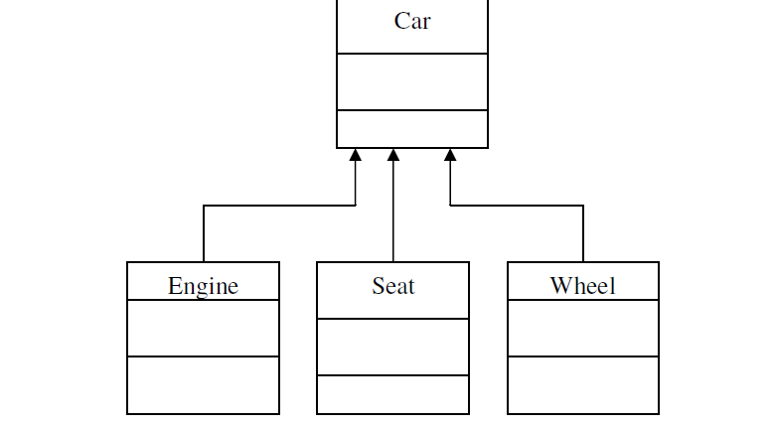

Slide 91
Static and Dynamic Binding:
Determining which function has to be involved at compile time is called static binding.
Static binding optimized the calls. (Ex) function call. The process of determining at run time which functions to involve is termed dynamic binding
Dynamic binding occurs when polymorphic call is issued. It allows some method invocation decision to be deferred until the information is known.
Example:
Cut operation in a edit submenu. It pass the cut operation to any object on the desktop, each or which handles the message in its own way.

Slide 92
Object Persistence:
Objects have a lifetime.
They are explicitly created and can exist for a period of time that has been the duration of the process in which they were created.
A file or database can provide support for objects having a longer lifeline, longer than the duration of the process for which they are created.
This characteristic is called object persistence.
Meta-Classes:
In an object-oriented system every thing is an object, what about a class? Is a class an object?. Yes, a class is an object.
So, If it is an object, it must belong to a class, such a class belong to a class called a meta-class (or) class or classes.

Slide 93
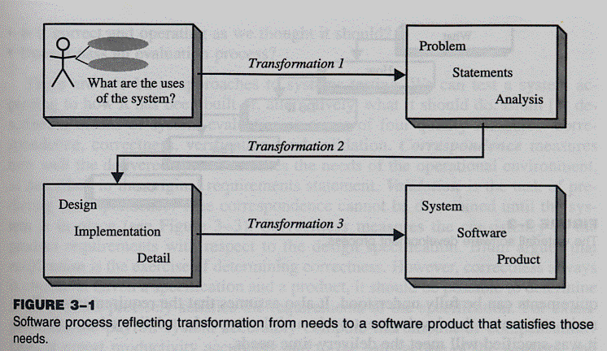
Object-oriented Systems Development Life Cycle:
Software development
Analysis, design, implementation, testing & refinement to transform users’ need into software solution that satisfies those needs
Object-oriented approach
more rigorous process to do things right

Slide 94
more time spent on gathering requirements, developing requirements model & analysis model, then turn into design model
need not see code until after 25% development time
SOFTWARE DEVELOPMENT PROCESS
Process to change, refine, transform & add to existing product
transformation 1(analysis) - translates user’s need into system’s requirements & responsibilities.how they use system can give insight into requirements, eg: analyzing incentive payroll - capacity must be included in requirements
transformation 2 (design) - begins with problem statement, ends with detailed design that can be transformed into operational system
bulk of development activity, include definition on how to build software, its development, its testing, design description + program + testing material

Slide 95
transformation 3 (implementation) - refines detailed design into system deployment that will satisfy users’needs
takes account of equipment, procedures, resources, people, etc - how to embed software product within its operational environment, eg: new compensation method program needs new form, gives new report.
Software process – transforming needs to software product

Slide 96
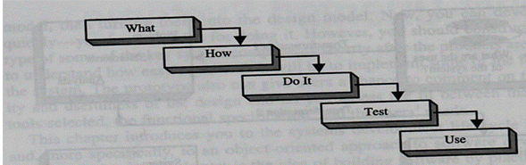
Waterfall Model – from ‘what’ to ‘use’

Slide 97
Why waterfall model fails
When there is uncertainty regarding what’s required or how it can be built
Assumes requirements are known before design begins
sometimes needs experience with product before requirements can be fully understood
Assumes requirements remain static over development cycle
product delivered meets delivery-time needs

Slide 98
Assumes sufficient design knowledge to build product
best for well-understood product
In able to cater software special properties or partially understood issues
doesn’t emphasize or encourage software reuse
Problem if environment changes
request changes in programs

Slide 99
Building high quality software
Goal is user satisfaction
how do we determine system is ready for delivery
is it now an operational system that satisfies users’needs
is it correct and operating as we thought it should ?
Does it pass an evaluation process ?

Slide 100
Approaches to systems testing
Test according to
how it has been built
what it should do

Slide 101
4 quality measures
correspondence
measures how well delivered system matches needs of operational environment, as described in original requirements statement
validation
task of predicting correspondence (true correspondence only determined after system is in place)
correctness
measures consistency of product requirements with respect to design specification
verification
exercise of determining correctness (correctness objective => always possible to determine if product precisely satisfies requirements of specification)

Slide 102
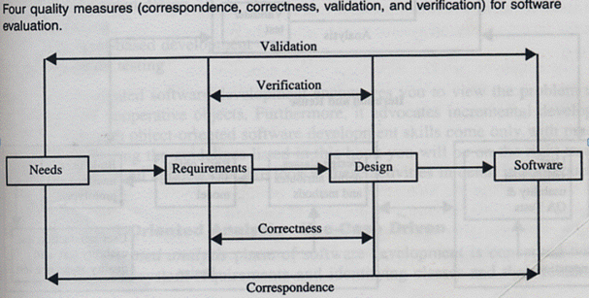
Quality Measures

Slide 103
Verification vs Validation
Verification
am I building the product right ?
Begin after specification accepted
Validation
am I building the right product ?
Subjective - is specification appropriate ? Uncover true users’ needs , therefore establish proper design ?
Begins as soon as project starts

Slide 104
Verification & validation independent of each other
even if product follows spec, it may be a wrong product if specification is wrong
eg: report missing, initial design no longer reflect current needs
If specification informal, difficult to separate verification and validation

Slide 105
Object-oriented approach: A use-case driven approach
Object-oriented software development life cycle consists of
Object-oriented analysis
Object-oriented design
Object-oriented implementation
Use-case model can be employed throughout most activities of software development
designs traceable across requirements, analysis, design, implementation & testing can be produced
all design decisions can be traced back directly to user requirements
usage scenarios can be test scenarios

Slide 106
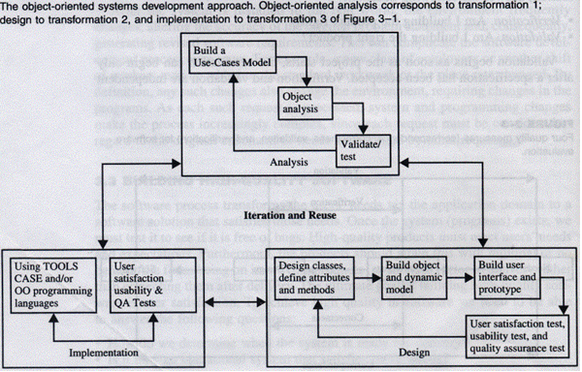
Object-oriented Systems Development Approach

Slide 107
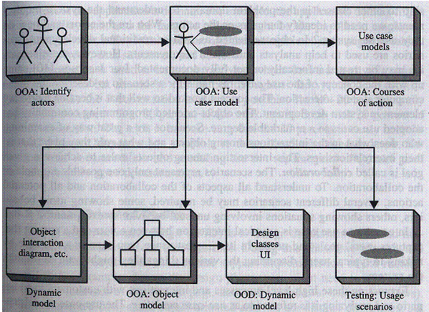
Using Jacobson et al. life cycle model – traceable design across development

Slide 108
Object-oriented software development
Activities
Object-oriented analysis - use case driven
Object-oriented design
Prototyping
Component-based development
Incremental testing
Encourages
viewing of system as a system of cooperative objects
incremental development

Slide 109
Object-oriented analysis - use-case driven
Use Case, is a name for a scenario to describe the user–computer system interaction.
Determine system requirements, identify classes & their relationship to other classes in domain
To understand system requirements
need to identify the users or actors
who are the actors ? How do they use system ?
Scenarios can help (in traditional development, it is treated informally, not fully documented)
Jacobson introduces concept of use case - scenario to describe user- computer system interaction

Slide 110
Use case
Typical interaction between user & system that captures users’ goal & needs
In simple usage, capture use case by talking to typical users, discussing various things they might want to do with system
can be used to examine who does what in interactions among objects, what role they play, intersection among objects’ role to achieve given goal is called collaboration
several scenarios (usual & unusual behaviour, exceptions) needed to understand all aspects of collaboration & all potential actions

Slide 111
use cased modeling
expressing high level processes & interactions with customers in a scenario & analyzing it
gives system uses, system responsibilities
developing use case is iterative
when use case model better understood & developed, start identifying classes & create their relationship

Slide 112
Identifying objects
What are physical objects in system ?
Individuals,organizations, machines, units of information, pictures, whatever makes up application/ make sense in context of real world
objects help establish workable system
work iteratively between use-case & object models
incentive payroll - employee, supervisor, office administrator, paycheck, product made, process used to make product
Intangible objects ?
Data entry screens, data structures

Slide 113
Documentation
– 80-20 rule
80% work can be done with 20% documentation
20% easily accessible, 80% available to few who needs to know
modeling & documentation in separable
good modeling implies good documentation

Slide 114
Object-oriented Design
Goal : to design classes identified during analysis phase & user interface
Identify additional objects & classes that support implementation of requirements
Eg. add objects for user interface to system (data entry windows, browse windows)
Can be intertwined with analysis phase
Highly incremental, eg. can start with object-oriented analysis, model it, create object-oriented design, then do some more of each again & again, gradually refining & completing models of system
Activities & focus of oo analysis & oo design are intertwined, grown not built

Slide 115
Object-oriented Design
First, build object model based on objects & relationship
Then iterate & refine model
Design & refine classes
Design & refine attributes
Design & refine methods
Design & refine structures
Design & refine associations

Slide 116
Guidelines in Object-oriented Design
Reuse rather than build new classes
Know existing classes
Design large number of simple classes rather than small number of complex classes
Design methods
Critique what has been proposed
Go back & refine classes

Slide 117
Prototyping
Prototype – version of software product developed in early stages of product’s life cycle for specific, experimental purposes
Enables us to fully understand how easy/difficult it will be to implement some features of system
Gives users chance to comment on usability & usefulness of user interface design
Can assess fit between software tools selected, functional specification & user needs
Can further define use cases, makes use case modeling easier
prototype that satisfies user + documentation -> define basic courses of action for use cases covered by prototype.

Slide 118
Important to construct prototype of key system components shortly after products are selected
Pictures worth a thousand words
Build prototype with use-case modeling to design systems that users like & need

Slide 119
Prototyping: old & new
Before: prototype thrown away when industrial strength version developed
New trend: (eg. rapid application development) prototype refined into final product
Prototype used as means to test & refine user interface & increase usability of system
As underlying prototype design becomes more consistent with application requirements, more detail can be added to application
Test, evaluate & build further till all components work properly Categories of Prototypes

Slide 120
Horizontal prototype
Simulation of interface (entire interface in full-featured system)
Contain no functionality
Quick to implement, provide good overall feel of system
Vertical prototype
Subset of system features with complete functionality
Few implemented functions can be tested in great depth
Hybrid prototypes
Major portions of interface established, features having high degree of risk are prototyped with more functionality

Slide 121
Analysis prototype
Aid in exploring problem domain, used to inform user & demonstrate proof of concept
Not used as basis of development, discarded when it has serve purpose
Final product use prototype concepts, not code
Domain prototype
Aid for incremental development of the ultimate software solution
Often used as tool for staged delivery of subsystems to users/other members of development team
Demonstrate the feasibility of implementation
Eventually evolve into deliverable product

Slide 122
Developing prototypes
Typical time from few days to few weeks
Should be done parallel with preparation of functional spec
Can result in modification of spec (some problems/features only obvious after prototype built) Should involve representation from all user groups that will be affected by project
To ascertain all that the general structure of the prototype meets requirements established for overall design

Slide 123
Purpose of review
Demo that prototype has been developed according to spec & that final spec is appropriate
Collect info about errors & problems in systems, eg user interface problems.
Give management & everyone connected with project glimpse of what technology can provide
Evaluation easier if supporting data readily available
Testing considerations must be incorporated in design & implementation of systems

Slide 124
Implementation: Component-based development
No more custom development, now assemble from prefabricated components
No more cars, computers, etc custom designed & built for each customer
Can produce large markets, low cost, high quality products
Cost & time reduced by building from pre-built, ready-tested components
Value & differentiation gained by rapid customization to targeted customers

Slide 125
Component-based development
Industrialised approach to system development, move form custom development to assembly of pre-built, pre-tested, reusable software components that operate with each other
Application development improved significantly if applications assembled quickly from prefabricated software components
Increasingly large collection of interpretable software components could be made available to developers in both general & specialist catalogs

Slide 126
Components themselves can be constructed from other components, down to prebuilt components/old-fashioned code written in prg languages like C
Visual tools/actual code can be used to glue together components
Visual glue – Digitalk’s Smalltalk PARTS, IBM VisualAge
Less development effort, faster, increase flexibility

Slide 127
Application Wrapping
Application/component wrapper
surrounds complete system, both code & data
Provides interface to interact with both new & legacy software systems
Off the shelf not widely available, mostly home-grown within organization

Slide 128
Software component
Functional units of prgs, building block offering collection of reusable services
Can request service form another component or deliver its own services on request
Delivery of services independent, component work together to accomplish task
Components can depend on one another without interfering one another
Each component unaware of context/inner workings of other components

Slide 129
Aspects of software development
OO concept – analysis, design, programming
Component-based – implementation, system intergration

Slide 130
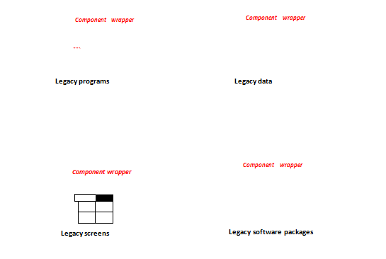
Component wrapping technology

Slide 131
Rapid Application Development (RAD)
Set of tools & techniques to build application faster than typically possible with traditional methods
Often used with software prototyping
Iterational development
Implement design & user requirements incrementally with tools like Delphi, VisualAge, Visual Basic, or PowerBuilder
Begins when design completed
Do we actually understood problem (analysis) ?
Does the system do what it is supposed to do (design) ?
Make improvement in each iteration

Slide 132
Incremental testing
Software development and all of its activities including testing are an iterative process.
Waiting until after development waste money & time
Turning over applications to quality assurance group not helping since they are not included in initial plan

Slide 133
Reusability
Major benefit of Object-oriented approach
For objects to be reusable, much effort must be spent of designing it
Design reusability
Effectively evaluate existing software components
Has my problem been solved ?
Has my problem been partially solved ?
What has been done before to solve problem similar to this one ?

Slide 134
Need
detailed summary info about existing software components
Some kind of search mechanism
Define candidate object simply
Generate broadly/narrowly defined query

Slide 135
Reuse Strategy
Information hiding
Conformance to naming standards
Creation & administration of an object repository
Encouragement by strategic management of reuse as opposed to constant redevelopment
Establish target for % of object in project to be reuse

Slide 136
The SW Development Process :
System development can be viewed as a process
Development = is a process of change, refinement, transformation, or addition to the existing product
Generally, the SW development process can be viewed as a series of transformations, where the output of one transformation becomes the input of the subsequent transformation. Refer figure 1 :
Figure 1 : SW process reflecting transformation from needs to a SW product that satisfies those needs

Slide 137
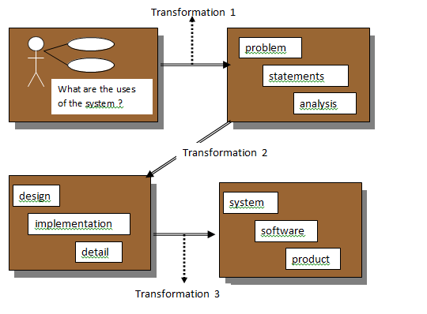

Slide 138
Transformation 1 (analysis) – translates the user’s needs into system requirements & responsibilities
Transformation 2 (design) – begins with a problem statement and ends with a detailed design that can be transformed into an operational system
Transformation 3 (implementation) – refines the detailed design into the system deployment that will satisfy the user’s needs
The emphasis on the analysis & design aspects of the SW life cycle, is intended to promote building high-quality SW (meeting the specifications and being adaptable for change )

Slide 139
THANK YOU

